Slide 1

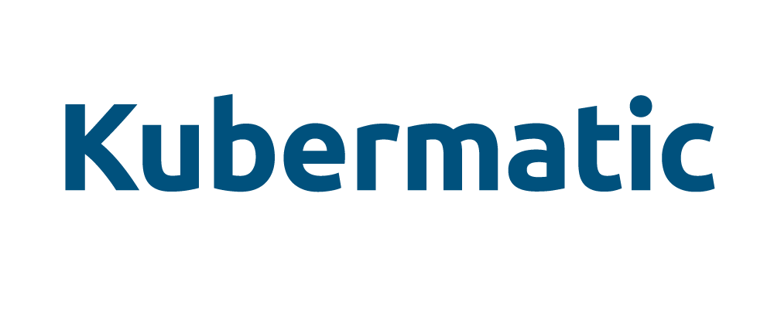

Accelerating Drug Discovery by Cooperative Competition through Open Source
APRIL 2020
Presented by
Bill Mulligan
Camille Marini

Slide 2
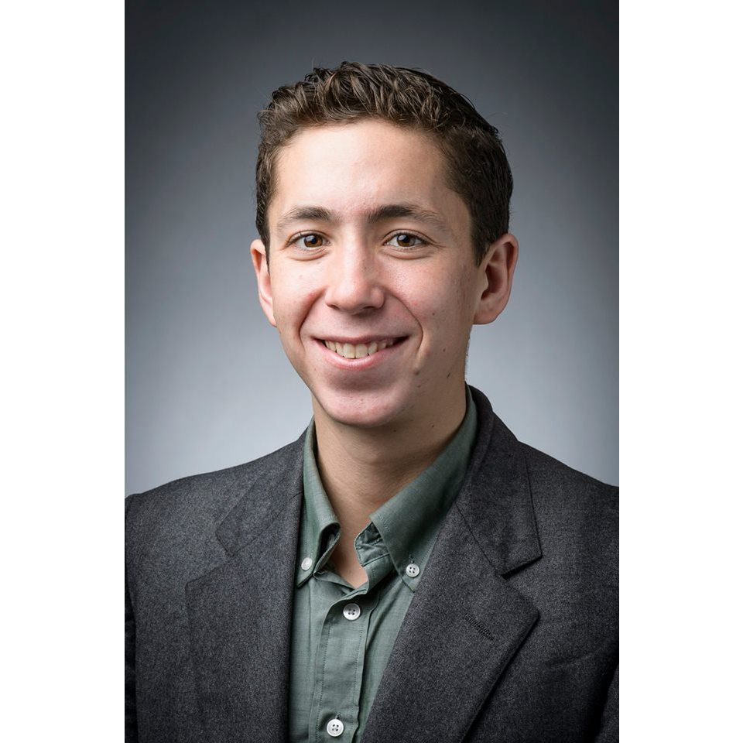
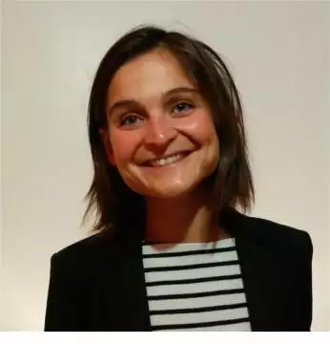
Speakers!
Bill Mulligan
@breakawaybilly
bill.mulligan@kubermatic.com
Camille Marini
@marini_camille
camille.marini@owkin.com

Slide 3






















MACHINE LEARNING LEDGER ORCHESTRATION FOR DRUG DISCOVERY
JUNE 2019 – MAY 2022
PHARMA PARTNERS
PUBLIC PARTNERS
This project has received funding from the Innovative Medicines Initiative 2 Joint Undertaking under grant agreement N° 831472. This Joint Undertaking receives support from the European Union’s Horizon 2020 research and innovation programme and EFPIA
“The statements and opinions presented here reflect the author's view and neither IMI nor the European Union, EFPIA, or any Associated Partners are responsible for any use that may be made of the information contained therein.”

Slide 4

THE MELLODDY OBJECTIVES
On average, bringing one drug to market costs €1.9 billion and 13 years¹.
The virtualization of parts of drug discovery by machine learning is a promising approach to improve efficiencies.
MELLODDY aims to show predictive benefits of modelling across tasks, data types and partners at the largest achievable scale.
In three yearly runs, the increasingly sophisticated platform will learn from:
> 10 million annotated small molecules
> 1 billion assay biological activity labels
Multiple high-complexity phenotypes at high throughput
Privacy preservation of data and federated models is paramount.
¹ DiMasi JA et al., 2016. Innovation in the pharmaceutical industry: new estimates of R&D costs. Journal of Health Economics 47, 20-33.

Slide 5




Owkin Connect - Hyperledger Fabric
Camille Marini, Owkin

Slide 6
FEDERATED LEARNING
Pharma A
Pharma B
Pharma C
Pharma D

Slide 7
FEDERATED LEARNING
Pharma A
Pharma B
Pharma C
Pharma D
Pharma A
Pharma B
Model Dispatcher
Pharma C
Pharma D

Slide 8


Privacy
Traceability
OPEN CORE APPROACH
Secure aggregation
PROPRIETARY
Powered by the Open-Source Framework Substra
Charts to deploy the MELLODDY platform
OPEN SOURCE
Setup of network nodes
Trustless traceability and orchestration Execution of ML tasks Simple programmatic interfaces
GitHub SubstraFoundation

Slide 9
ASSETS
Pharma A
Pharma B
Data
Non sensitive Metadata for ML orchestration
Model updates
Model
Dispatcher
Pharma C
Pharma D

Slide 10
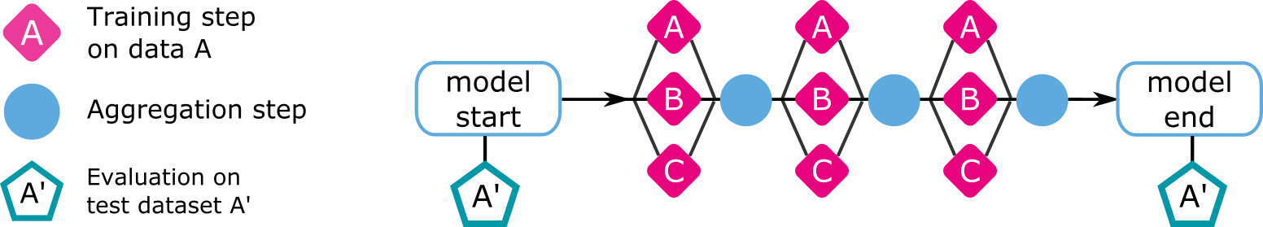
COMPUTE PLANS
Set of training, aggregation and evaluation tasks
A’
A
B
B’
C
D
C’
D’

Slide 11




ARCHITECTURE OVERVIEW
Techno
Peer
Ledger
Chaincode
Peer
Ledger
Peer
Ledger
Chaincode
Chaincode
Node A
Model Dispatcher
Peer
Ledger
Peer
Ledger
Storage
Chaincode
Chaincode
Storage
Compute
Compute
Substra-tools
Substra-tools
Substra
backend
Fabric SDK
Fabric SDK
Frontend
Substra
backend
Frontend
CLI
SDKPy
SDKPy
CLI

Slide 12
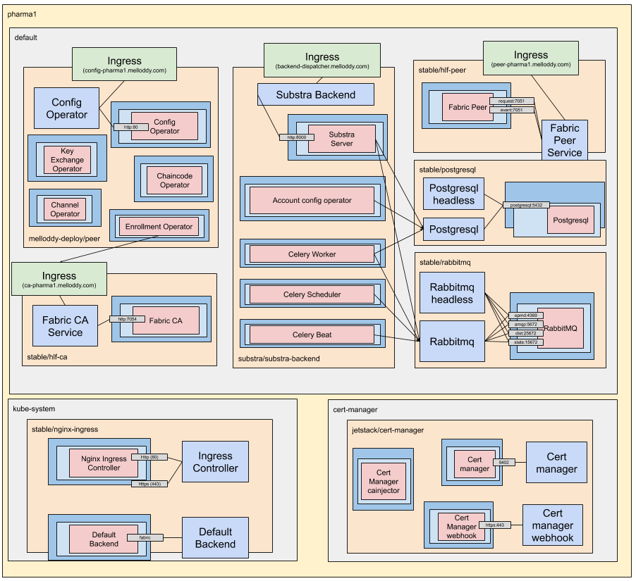
Pharma cluster

Slide 13
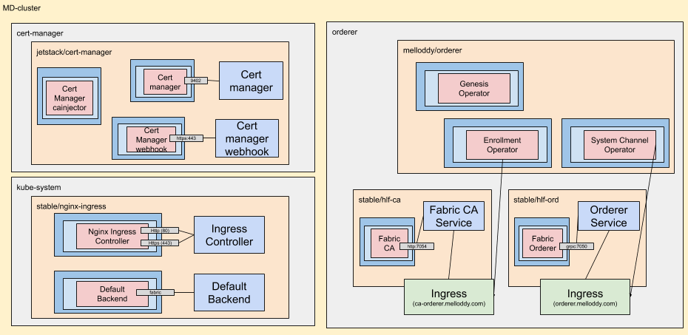
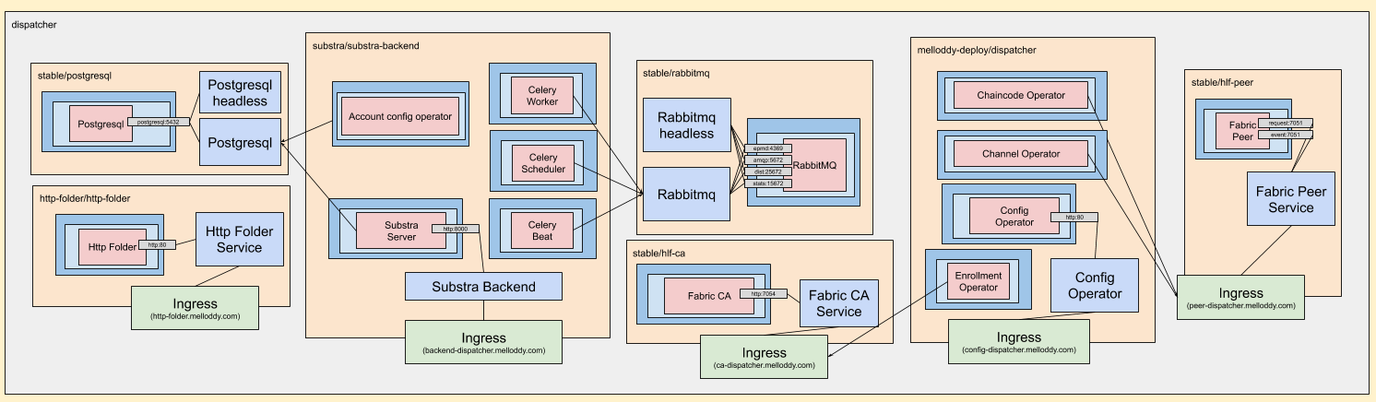
Model Dispatcher Cluster

Slide 14
Kubermatic Kubernetes Platform - Kubernetes
Bill Mulligan, Kubermatic

Slide 15
Kubermatic Kubernetes Platform - Kubernetes
KubeOne Cluster

Slide 16


KubeOne Cluster - Vanilla Kubernetes
KubeOne Cluster
K8s Master
K8s Master
K8s Master
Worker
Worker
Worker

Slide 17

Kubermatic Kubernetes Platform - Kubernetes
KubeOne Cluster
Kubermatic
Kubermatic

Slide 18
Kubermatic Kubernetes Platform - Kubernetes
KubeOne Cluster
Kubermatic
Kubermatic
API
Controller
UI

Slide 19
Kubermatic Kubernetes Platform - Kubernetes
KubeOne Cluster Central Services
Kubermatic
KubeOne Cluster Pharma 1
KubeOne Cluster Pharma 2

Slide 20
Kubermatic Kubernetes Platform - Kubernetes
KubeOne Cluster Central Services
Kubermatic
User k8s Master
API
Scheduler
Controller
etcd
KubeOne Cluster Pharma 1
KubeOne Cluster Pharma 2

Slide 21
Kubermatic Kubernetes Platform - Kubernetes
KubeOne Cluster Central Services
Kubermatic
User k8s Master
API
Scheduler
Controller
etcd
User Cluster Central Services
KubeOne Cluster Pharma 1
KubeOne Cluster Pharma 2
User k8s Worker
User k8s Worker

Slide 22
Kubermatic Kubernetes Platform - Kubernetes
KubeOne Cluster Central Services
Kubermatic
User k8s Master
API
Scheduler
Controller
etcd
User Cluster Central Services
KubeOne Cluster Pharma 1
KubeOne Cluster Pharma 2
User k8s Worker
User k8s Worker
User k8s Master
User k8s Master
API
Scheduler
Controller
etcd
API
Scheduler
Controller
etcd
User Cluster Pharma 1
User Cluster Pharma 2
User k8s Worker
User k8s Worker
User k8s Worker
User k8s Worker

Slide 23
Benefits of Using Open Source Software
Non-competitive code is available and can be freely shared and audited
Creates a consistent way to create and deploy infrastructure and software across companies
Run the same software without having to run on the same infrastructure
Protection against malicious actors

Slide 24
Other industries
Many other industries face the problem that by leveraging machine learning on collaborative data, they could improve performance, but the data is also their competitive advantage
Insurance
Logistics
Finance

Slide 25




MELLODDY CONSORTIUM CONTACTS
Want to know more?
Visit and subscribe to our newsletter!
www.melloddy.eu/
PROJECT COORDINATOR
Mathieu Galtier, Owkin
PHARMA LEAD
Hugo Ceulemans, Janssen
SPEAKERS
Bill Mulligan, Kubermatic
Camille Marini, Owkin
TWITTER
@MELLODDY_IMI
LINKEDIN
melloddy-consortium

Slide 26
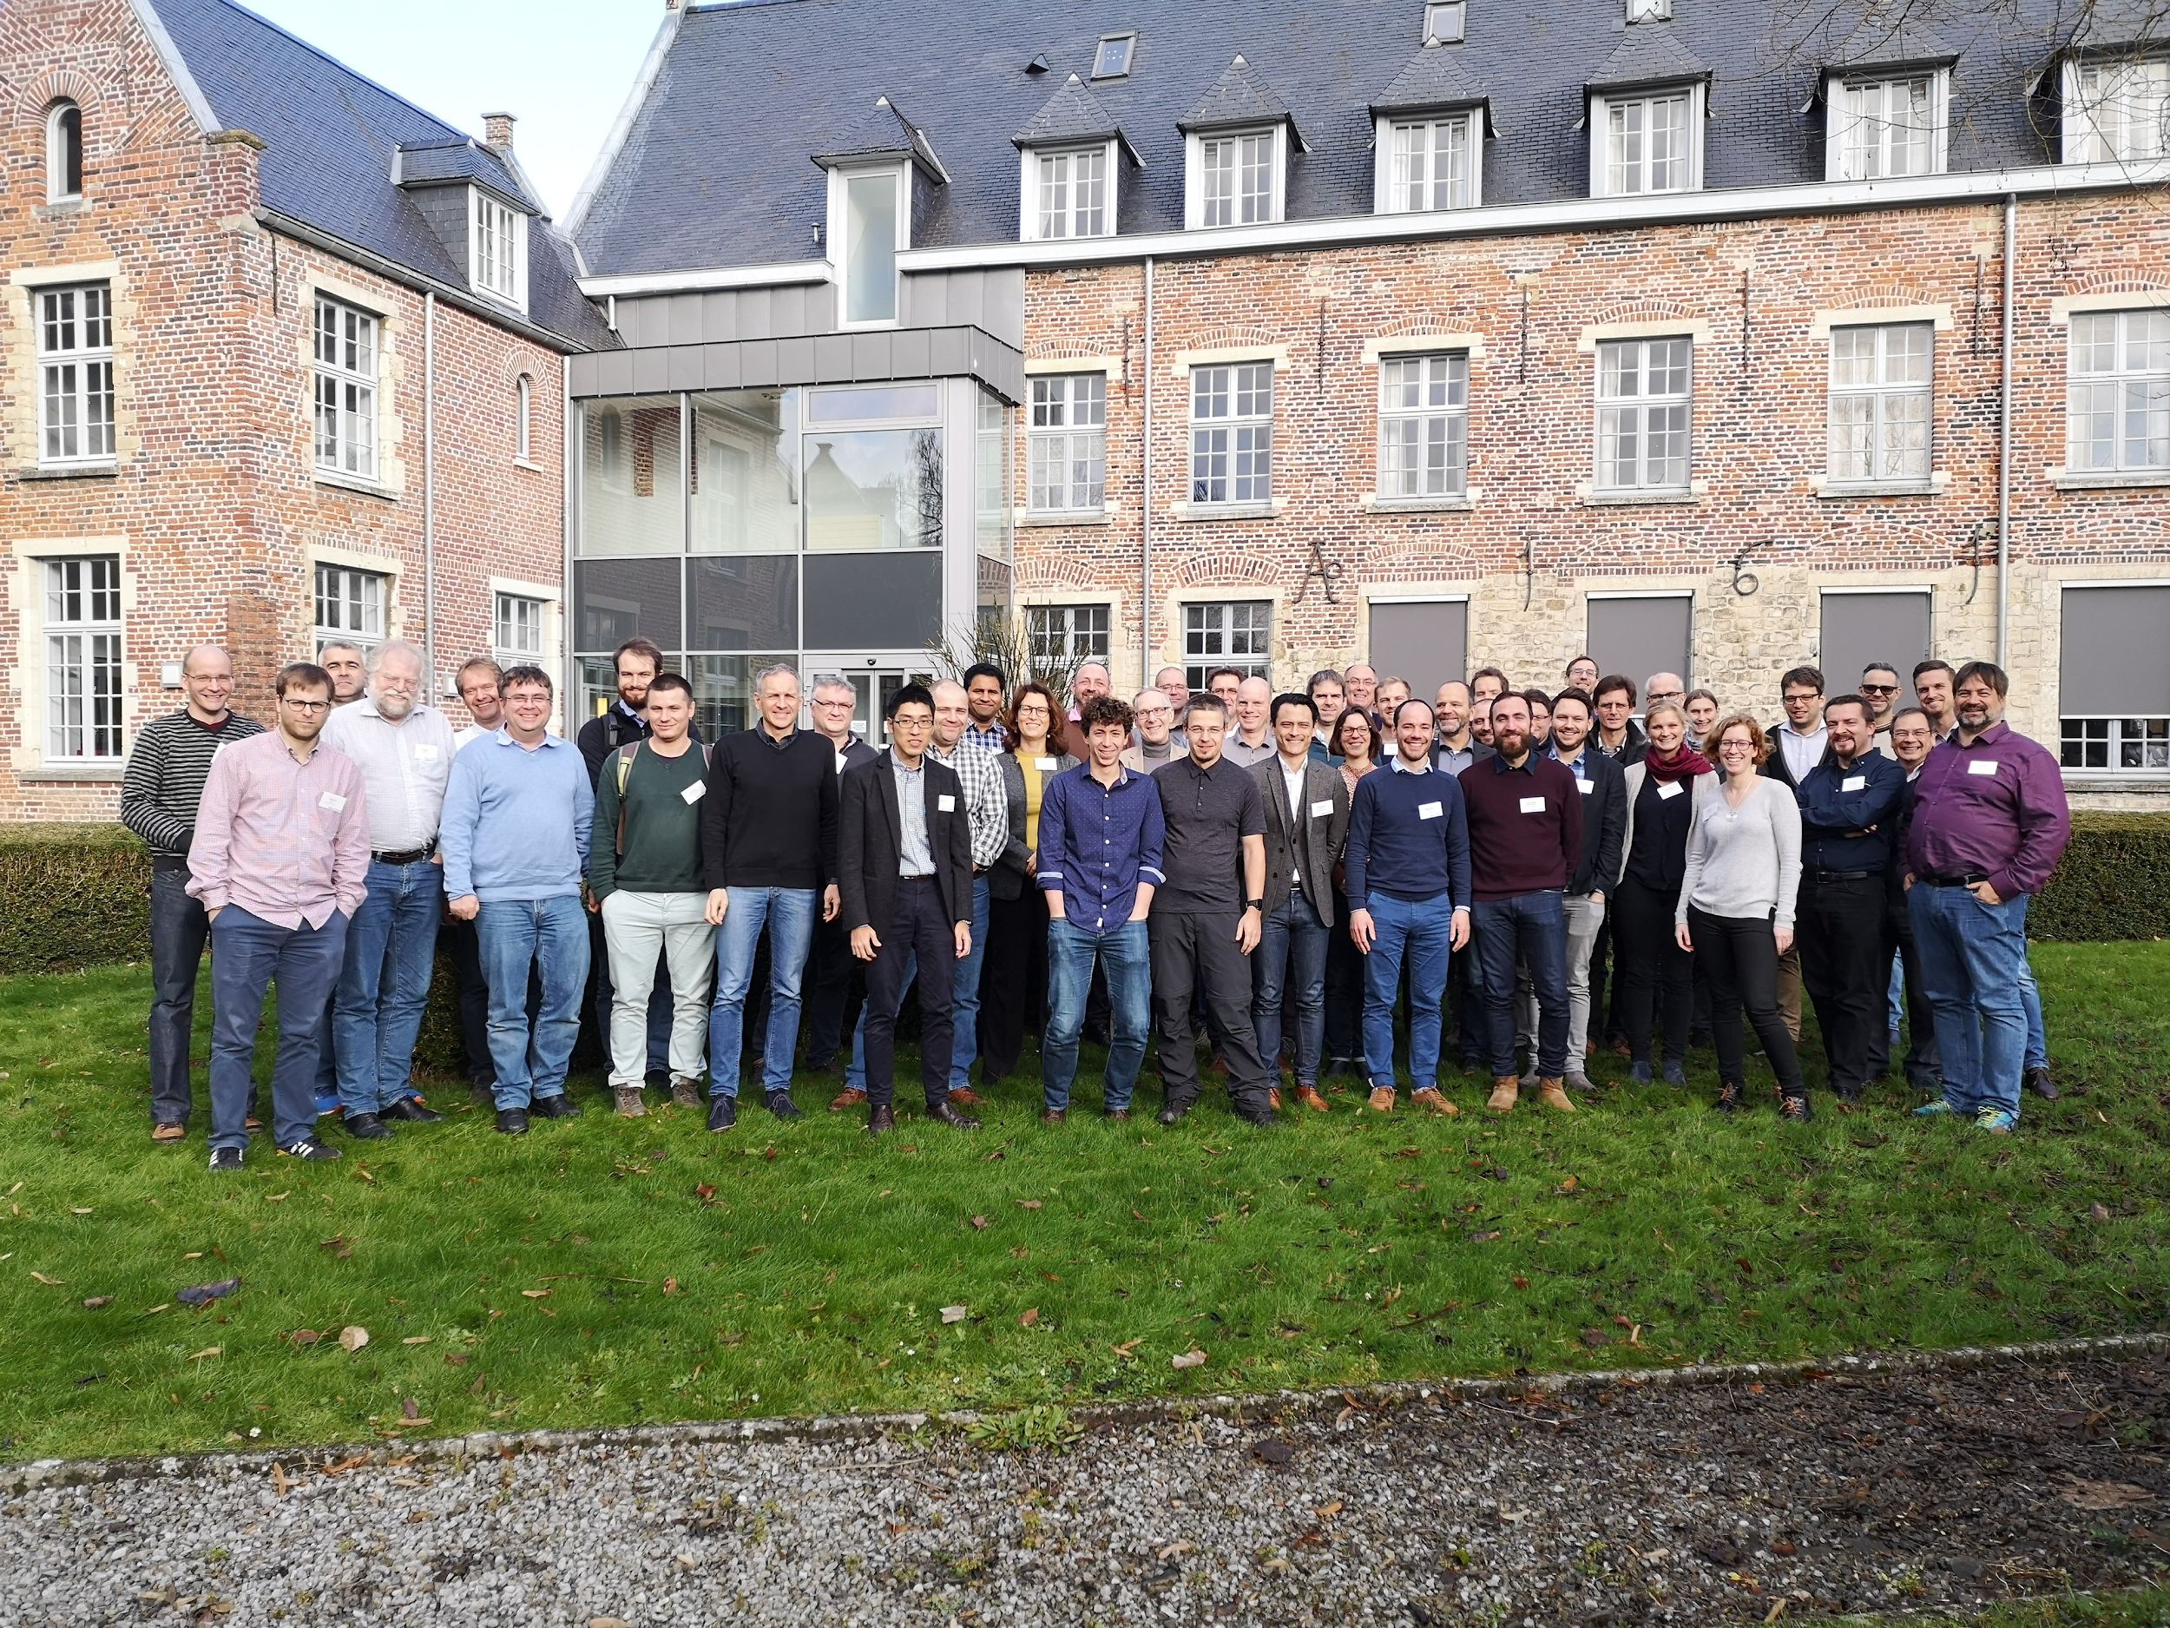
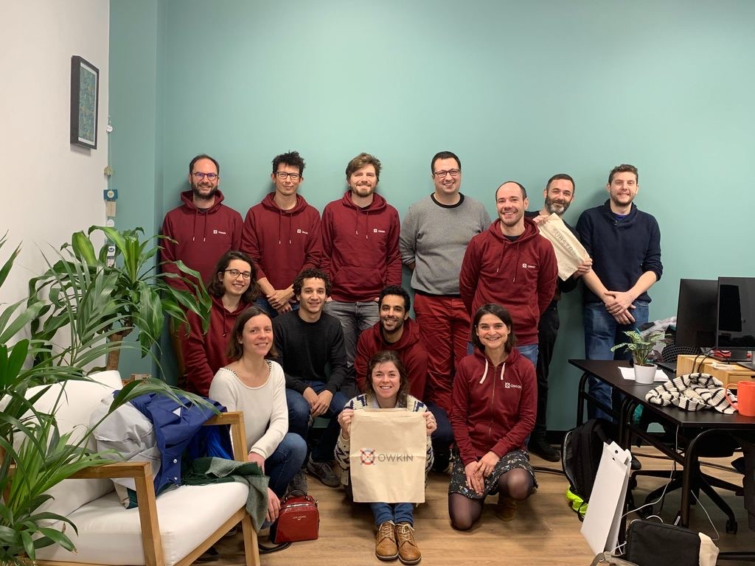

Thank you !
MELLODDY receives funding from the Innovative Medicines Initiative 2 Joint Undertaking under grant agreement N° 831472. This Joint Undertaking receives support from the European Union’s Horizon 2020 research and innovation programme and EFPIA

Slide 27
Appendix

Slide 28

Why do we need Open Source?
A pharma case study
Friedrich Rippmann, Merck

Slide 29
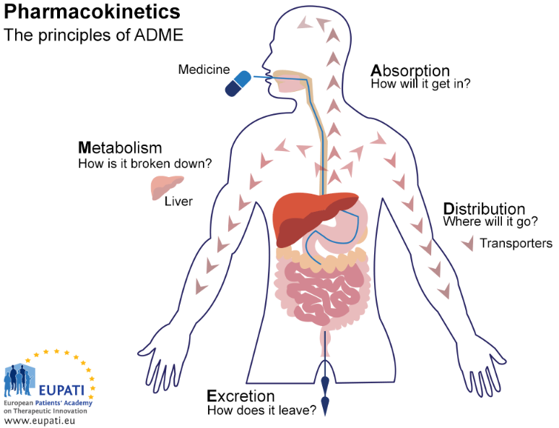
THE DRUG AND YOUR BODY

Slide 30
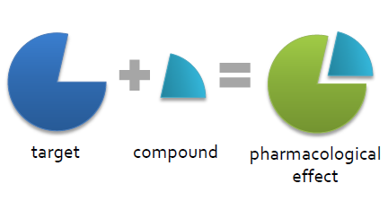
WHAT DO WE WANT?
The goal of a drug is to
modulate the function of
a disease target protein which
results in a wanted
effect in the human body.
usually a protein chemical molecule

Slide 31
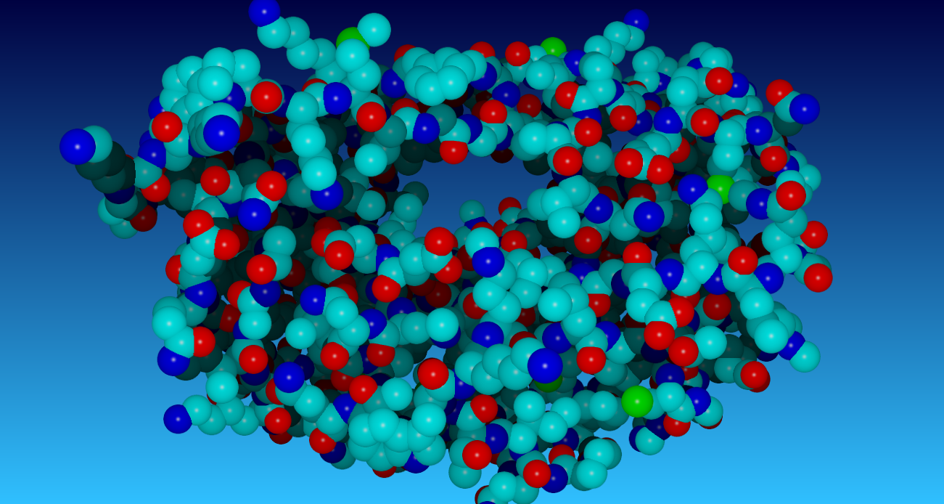
Example of a drug target: HIV protease inhibitor

Slide 32
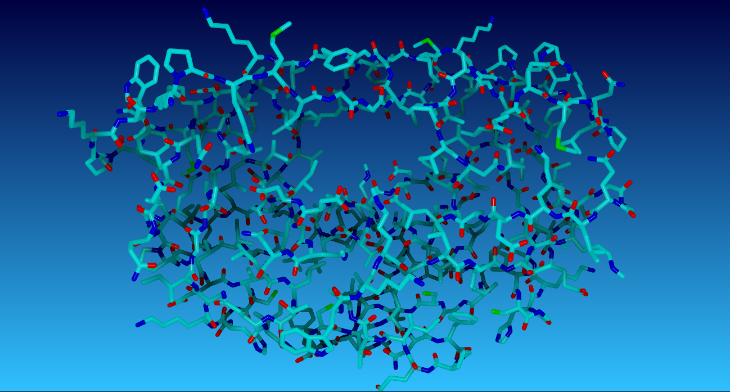
Example of a drug target: HIV protease inhibitor

Slide 33
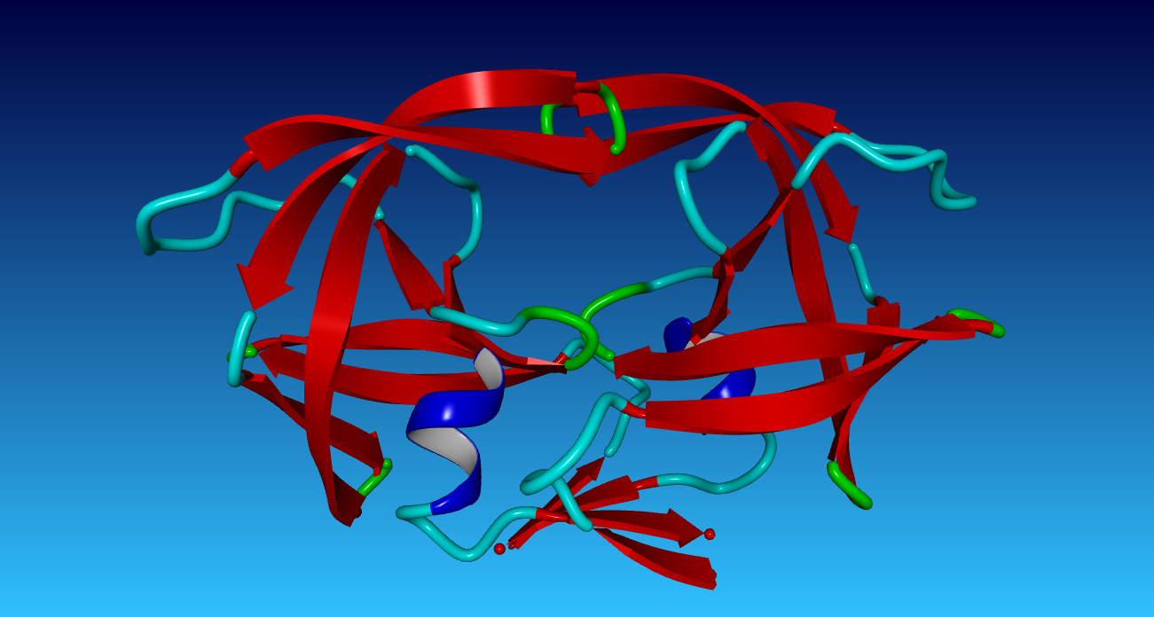
Example of a drug target: HIV protease inhibitor

Slide 34
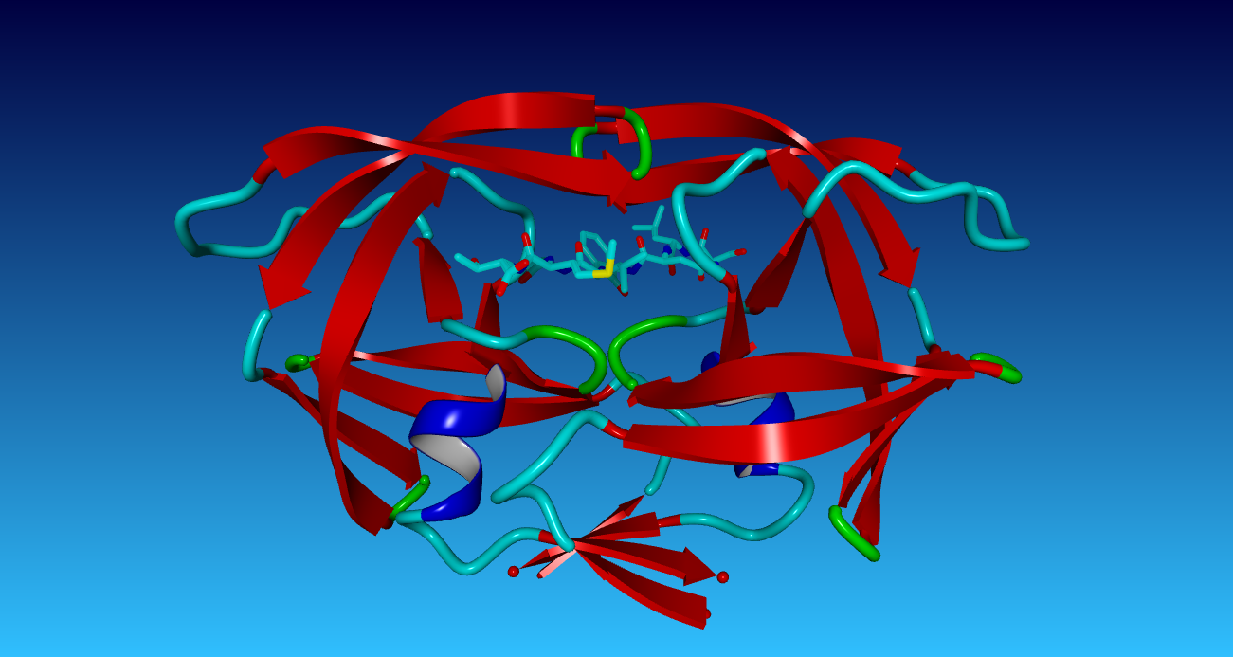
Example HIV protease inhibitor

Slide 35
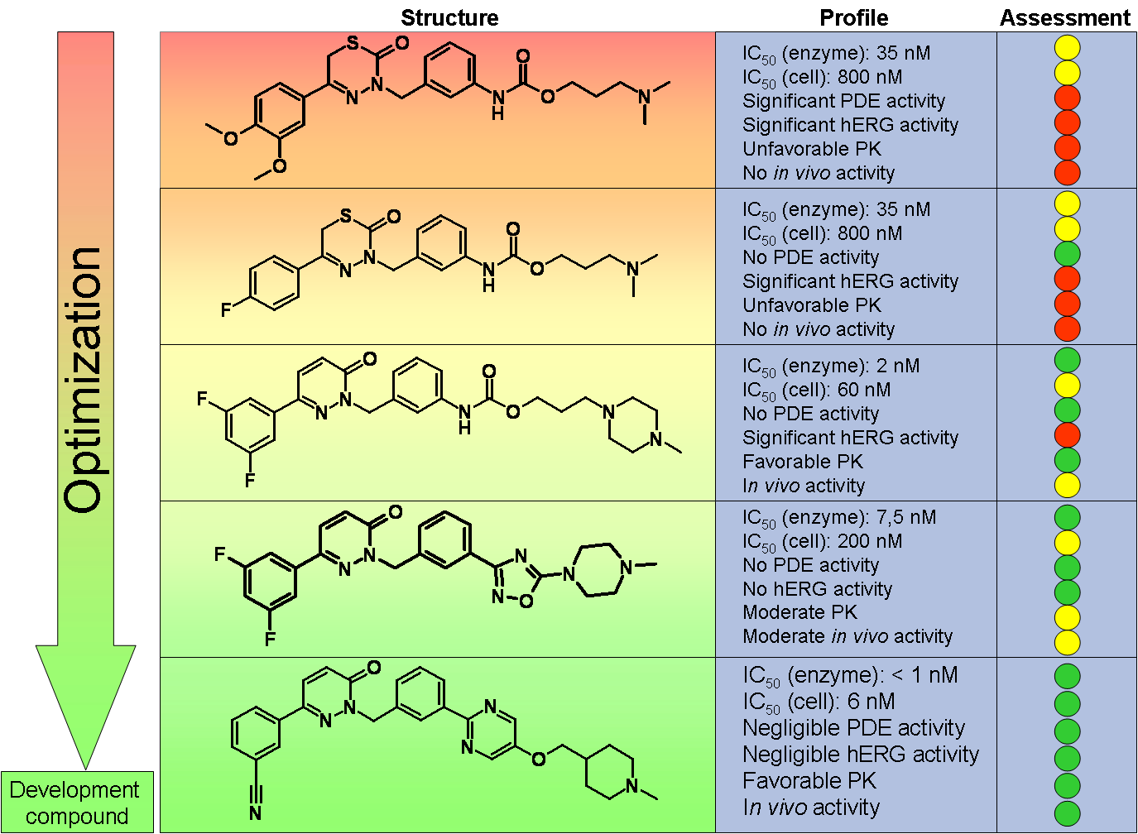
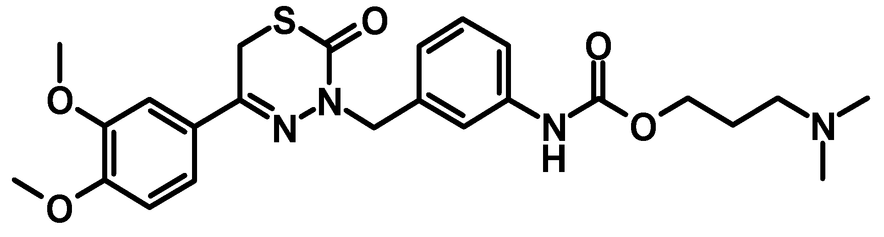
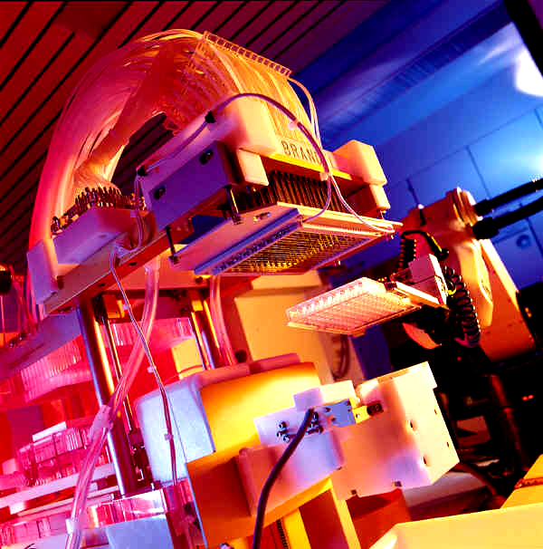
HIT-TO-LEAD-TO-DRUG CANDIDATE OPTIMIZATION
Initial hit, found in High Throughput Screening:

Slide 36

HIT-TO-LEAD-TO-DRUG CANDIDATE OPTIMIZATION
Initial hit, found in High Throughput Screening:
=> Assay 1 => Assay 2 => Assay 3 => Assay 4 => Assay 5 => Assay 6

Slide 37
How can we accelerate drug discovery?
Machine learning benefits from data volume; activity data of each individual company documents its own chemistry only
Models tend to improve with additional data, documenting more chemistry
A pharma company’s competitiveness depends on proprietary data and IP which must be kept strictly secure
Can our machine learning benefit from collaborative data scaling while maintaining the strict security of competitive data?

Slide 38
Open Source Software permits Cooperative Competition
Key Open Source projects used to create a trustless joint machine learning platform
Linux
Tensorflow
Hyperledger Fabric
Kubernetes

